Slide 1
Afdharikaa E-Mart!!!
Presented by,
S.Kavipriya,
M.Afreen,
G.R.Dharanya.

Slide 2
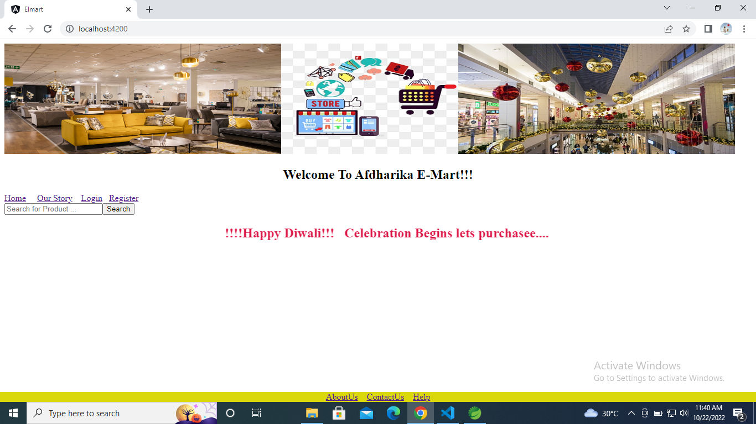
WELCOME PAGE

Slide 3
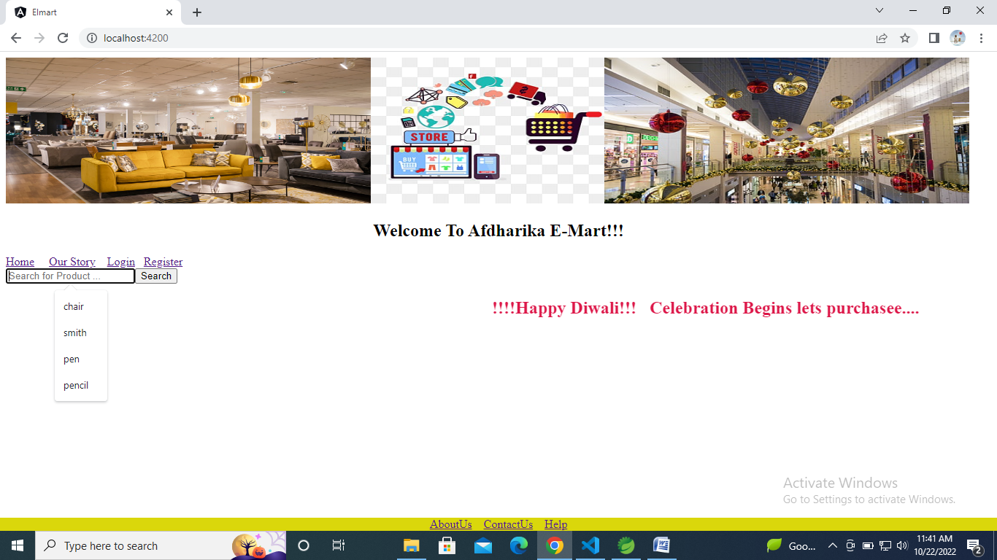
SEARCH PRODUCT

Slide 4
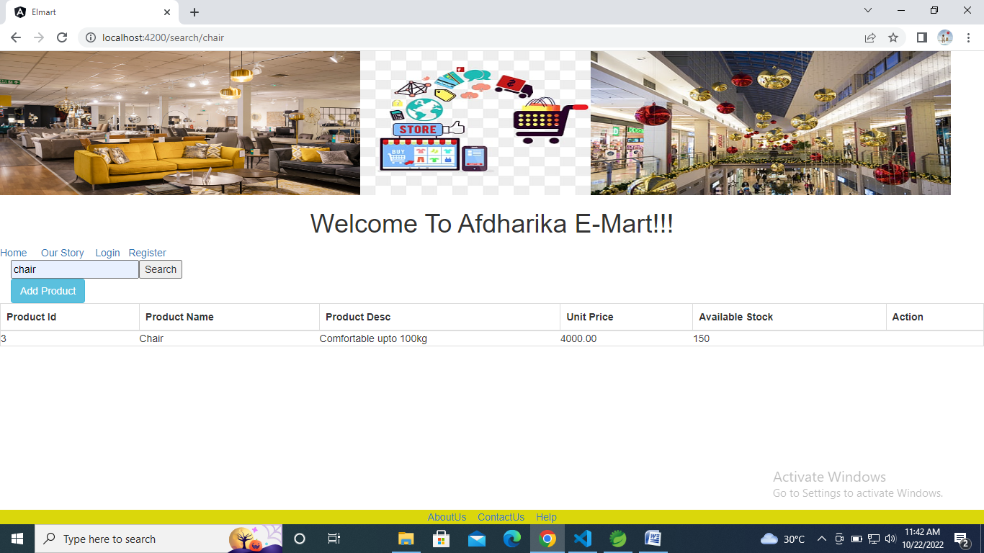

Slide 5
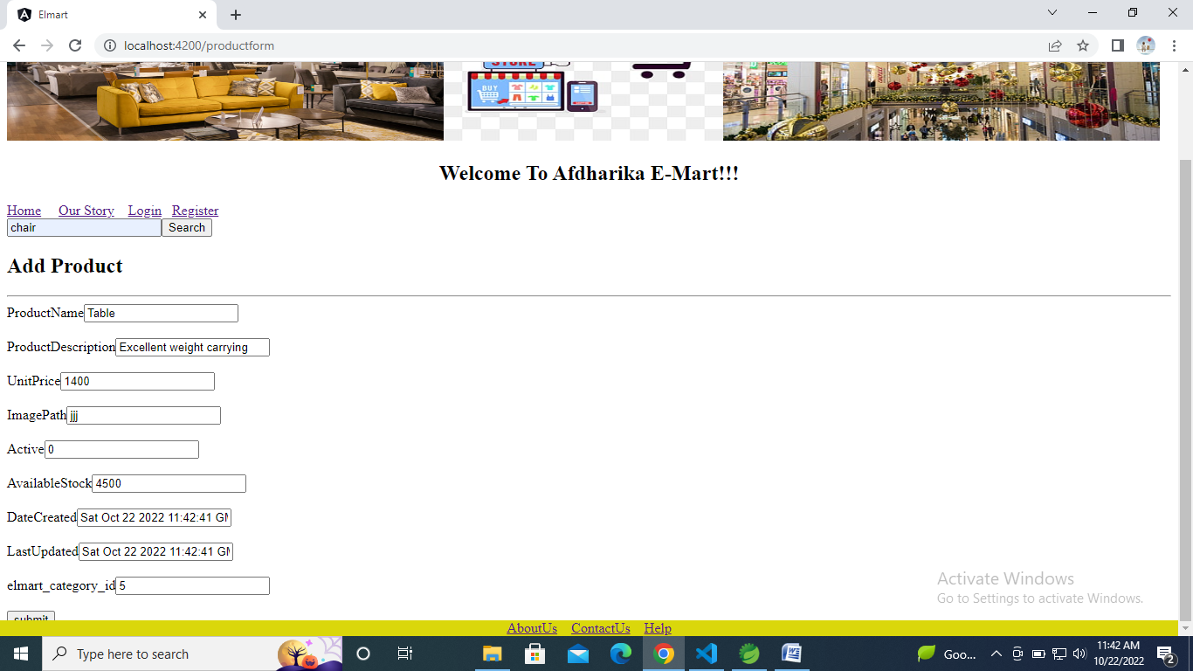
ADD PRODUCT

Slide 6
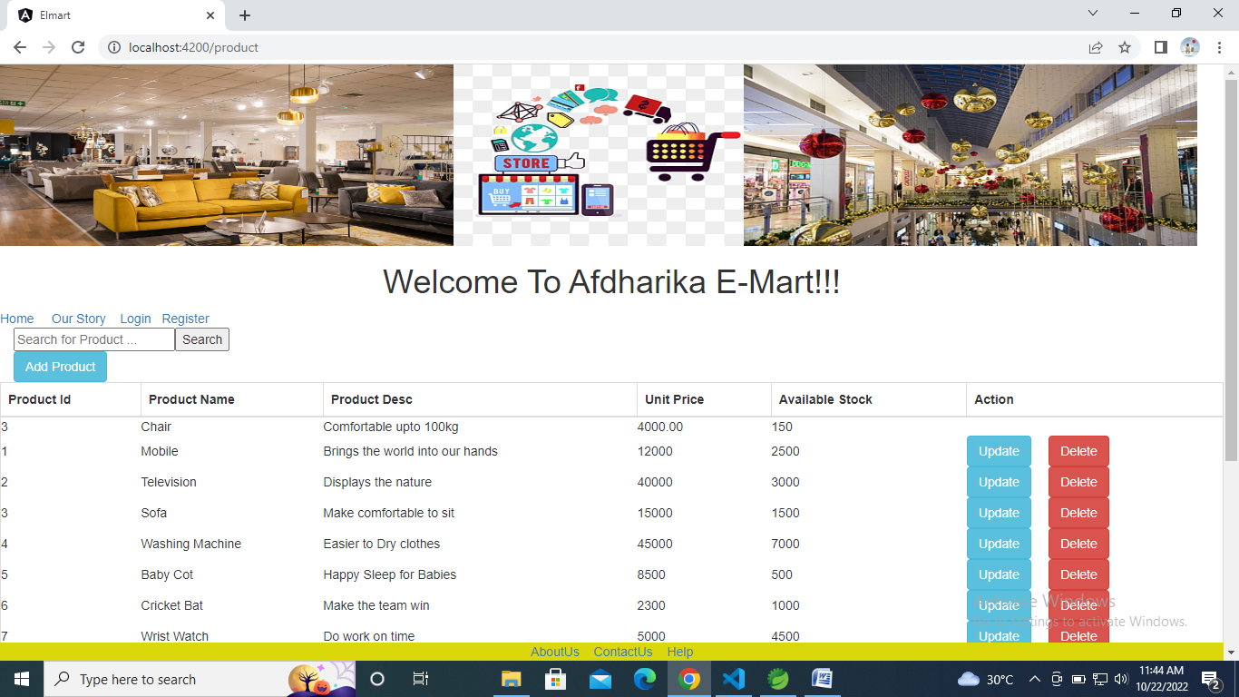

Slide 7
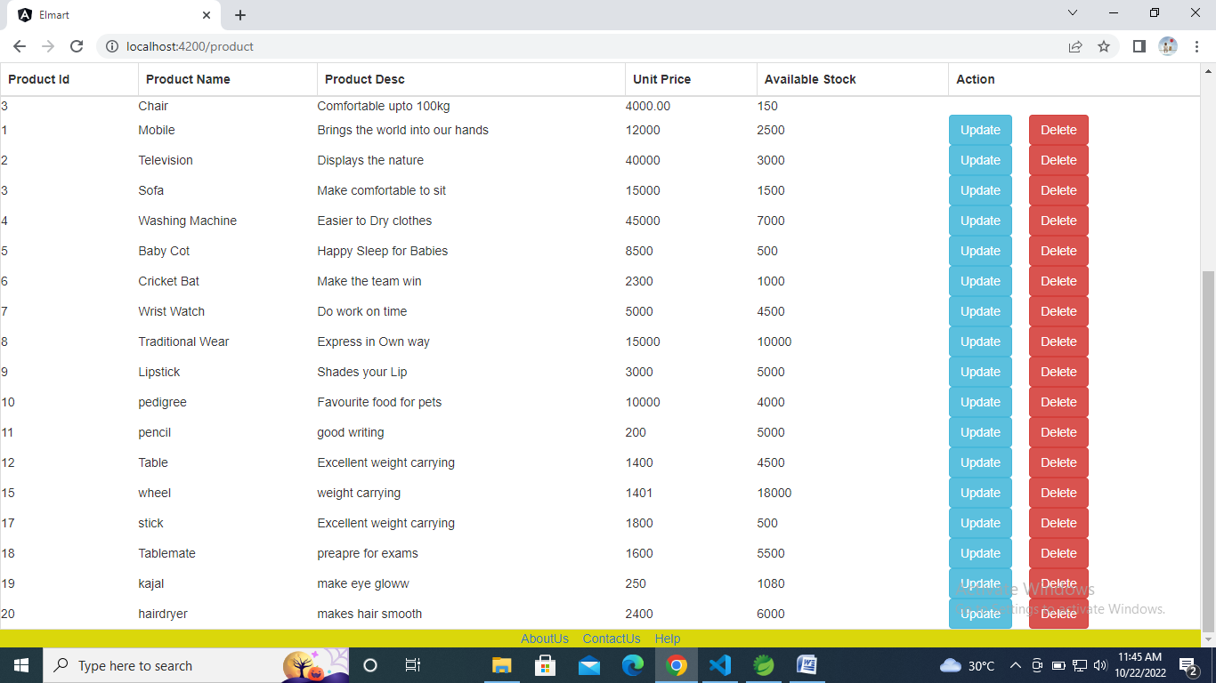

Slide 8
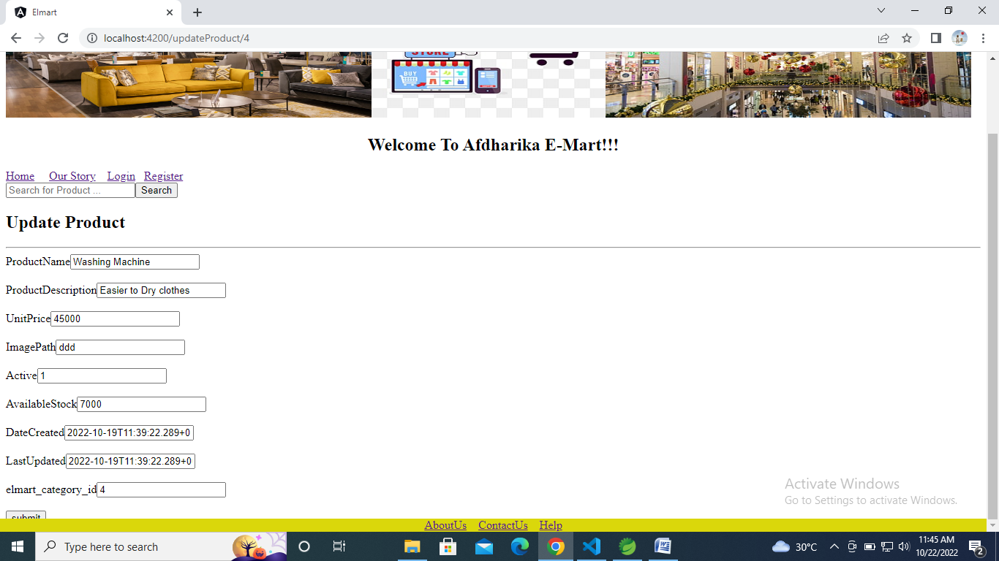
UPDATE PRODUCT

Slide 9
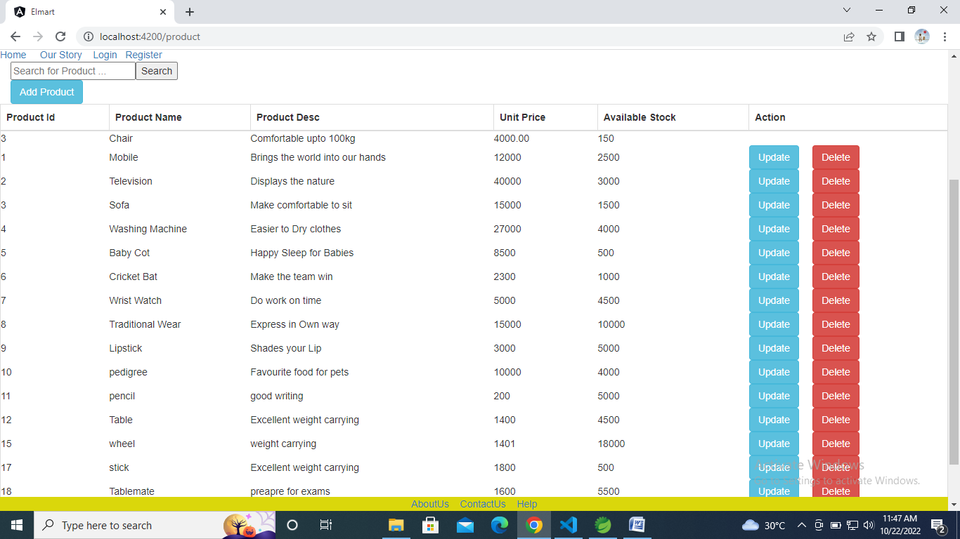

Slide 10
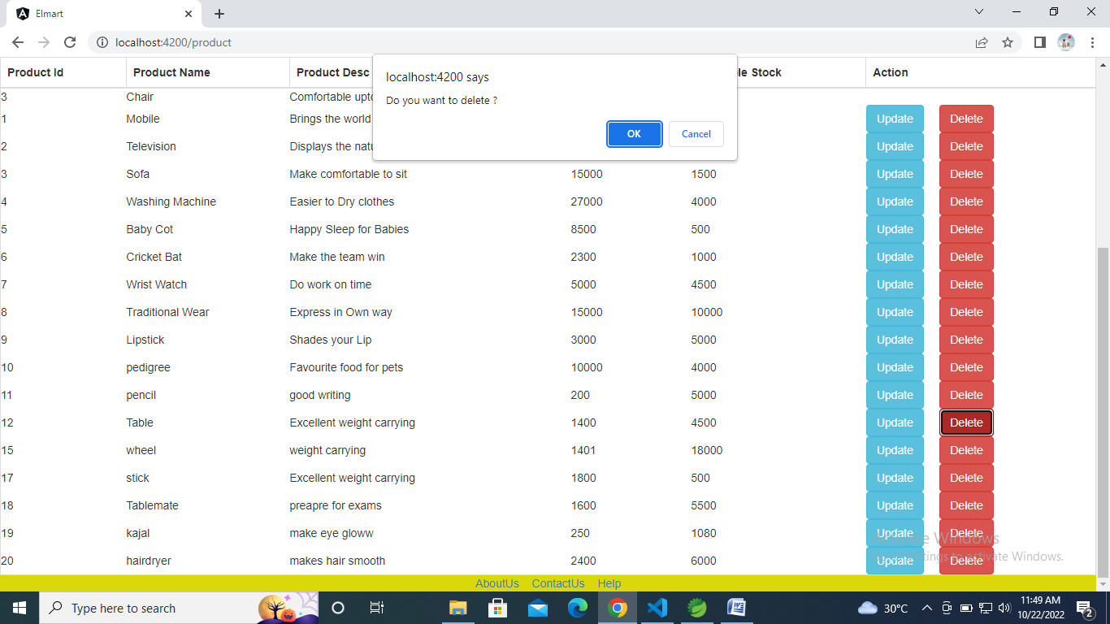
DELETE PRODUCT

Slide 11
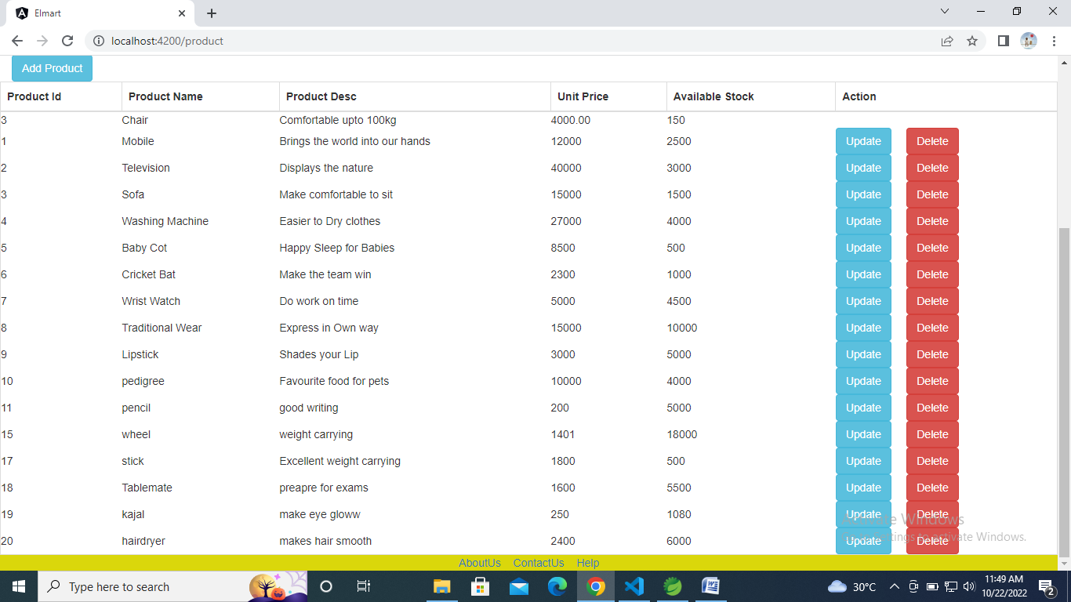

Slide 12
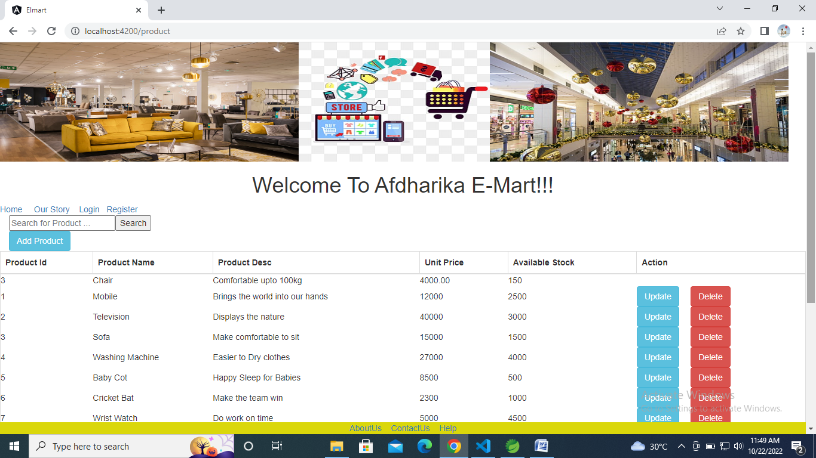

Slide 13
THANK YOU….

